Slide 1


Cutting Through the Clutter of School Finance Data & Research – Applications in Virginia
April 25, 2019
Chris Duncombe, Policy Director
The Commonwealth Institute for Fiscal Analysis

Slide 2

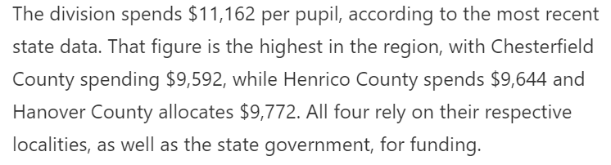
Common Perspectives in the Media
Excerpt from: Richmond City Council: School system's finances need more oversight

Slide 3
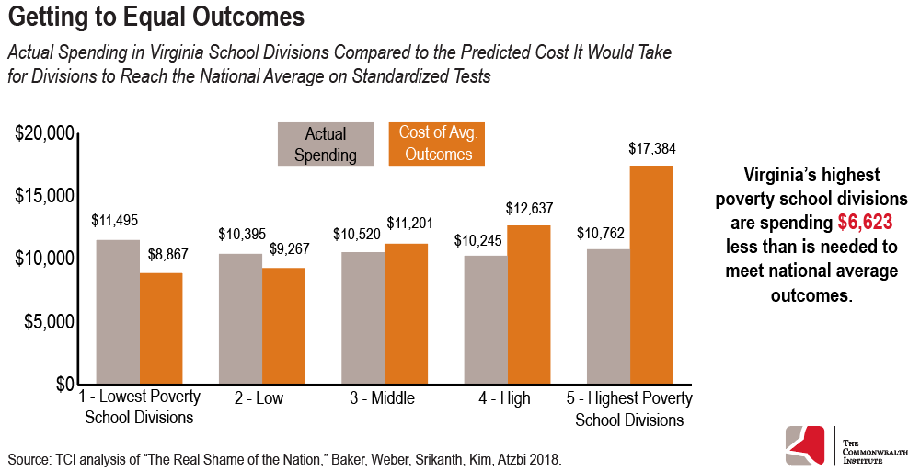
Clarifying the Context

Slide 4
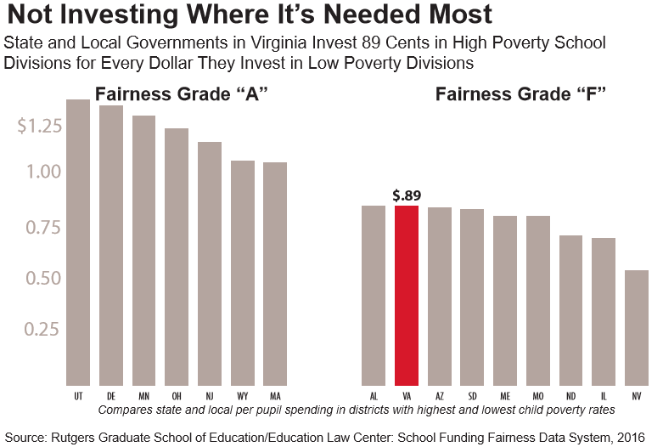
Virginia Among Regressive States

Slide 5
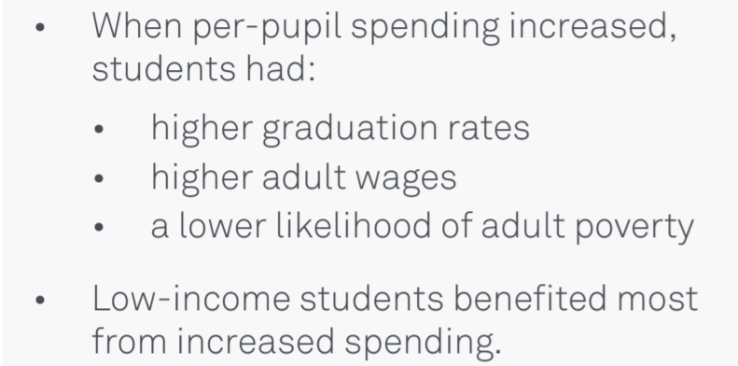
Research Shows Money Matters
https://www.ipr.northwestern.edu/publications/policy-briefs/school-spending-policy-research-brief-Jackson.pdf

Slide 6
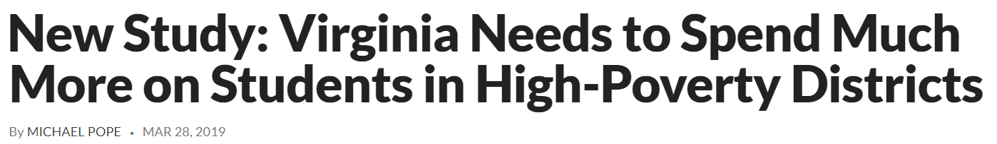
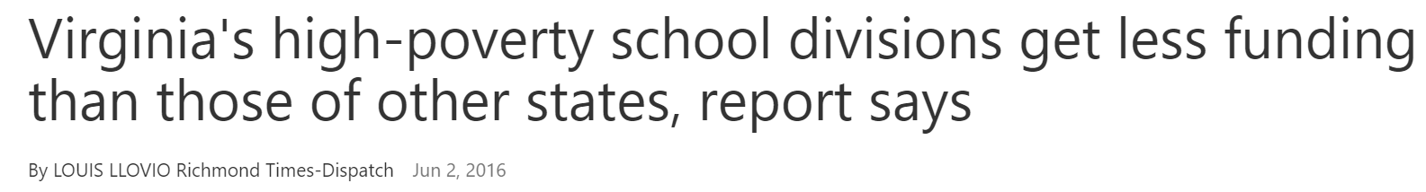
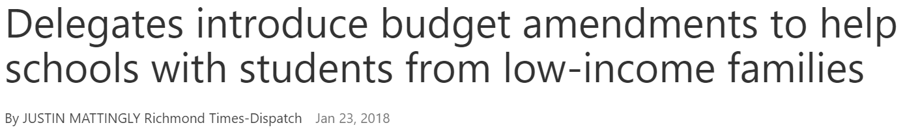
Shaping the Discourse

Slide 7
Questions?
Chris Duncombe, Policy Director
The Commonwealth Institute for Fiscal Analysis
chris@thecommonwealthinstitute.org

