Slide 1
Getting on the same page:
A call for improving education finance research Practices
Cutting Through the Clutter of
School Finance Data & Research
Presentation by Jesse Levin
for Albert Shanker Institute Lunch Discussion
April 25, 2019

Slide 2
Introduction and Motivation

Slide 3
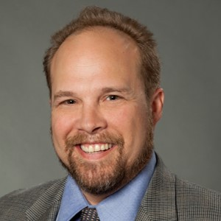
Meet the Presenter
Jesse Levin, Ph.D.
Principal Research Economist

Slide 4


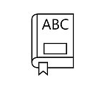








Some Questions of Interest
What are the levels of education funding and spending in aggregate?
How does funding and spending vary across:
  Schools and districts
  Grade levels
  Categories of student needs
How are educational dollars being spent and what are we getting for our money:
  Cost-effectiveness
  Benefit-cost
How much should we be dedicating to public education?
How should educational funding be distributed and spent?
These questions invariably involve thinking about efficiency and equity.
Notes:
Note there is a fundamental difference between equity and equality the context of provision of educational funding.
Educational Opportunity – Providing access to services sufficient to allow for a reasonable expectation of achieving educational outcomes given an individual makes a reasonable effort (Roemer, J. (1998).
Equality of Opportunity. Cambridge: MA, Harvard University Press.).
Suggested Reading
Chambers, J., & Levin, J. (2009). Determining the cost of providing an adequate education for all students. Washington, DC: National Education Association.

Slide 5





Improvements in Our Practice Are Needed
Data – Methods used to collect, process and compile fiscal information.
Research – Analytical approaches and measures used to translate data into meaningful results capable of informing policy.
Communication – Conveying research results so that they are both understandable and actionable.
Having data and research that are both consistent and credible is essential to making an impact!
Data Methods Research Approaches Communication

Slide 6
Example of How We Can Evaluate Data Quality
BIG IDEA: Check comprehensiveness, consistency and accuracy of school-level spending data.
Comprehensiveness – Degree to which spending is accounted for and appropriately attributed to individual schools.
  Tracked versus Allocated Dollars – Spending not directly tracked to schools must be allocated to schools using a justifiable method.
Accuracy – Precision with which allocated spending measures dollars spent on individual school sites.
Consistency – Extent to which fiscal data are collected and processed consistently across organizational units (states, districts and schools) and data collection efforts.
Useful References
  Study of Funding Provided to Public Schools and Public Charter Schools in Maryland (Levin et al., 2016)
  Exploring the Quality of School-Level Expenditure Data: Practices and Lessons Learned in Nine Sites (U.S. Department of Education, 2017).
  Study of Spending in Public Charter and Traditional Schools in California (Atchison, Levin and Brodziak, 2018).
Notes:
Levin, J., Baker, B., Atchison, D., Brodziak, I., Boyle, A., Hall, A., and Becker, J. (2016). Study of Funding Provided to Public Schools and Public Charter Schools in Maryland. San Mateo, CA: American Institutes for Research. Retrieved 04/22/19 at http://marylandpublicschools.org/stateboard/Documents/01242017/TabG-CharterPublicSchoolFundingStudy.pdf.
U.S. Department of Education, Office of Planning, Evaluation and Policy Development, Policy and Program Studies Service, Exploring the Quality of School-Level Expenditure Data: Practices and Lessons Learned in Nine Sites, Washington, D.C., 2017. Retrieved 04/22/19 at https://www2.ed.gov/rschstat/eval/title-i/quality-expenditure-data/report.pdf.

Slide 7
Example of How We Can Improve Research 1
BIG IDEA: Commit to using metrics that measure items of interest (e.g., equity) with sufficient rigor.
An important way to tighten up analyses of funding or spending is to condition results on applicable cost factors whenever possible:
  Student Needs
  Scale of Operations
  Geographic Variation in Input Prices
Comparison of Charter and Traditional School Spending in California
  Comparative analysis of charter versus traditional school spending for two CMOs operating in Los Angeles and Oakland.
  Because student needs differed systematically between charter and traditional schools conditional analysis was warranted.
  Generated conditional results using regression analysis.
  Conducted analysis showing expected average spending on charters if they were treated as if they were traditional schools.
Notes:
U.S. Department of Education, Office of Planning, Evaluation and Policy Development, Policy and Program Studies Service, Exploring the Quality of School-Level Expenditure Data: Practices and Lessons Learned in Nine Sites, Washington, D.C., 2017. Retrieved 04/22/19 at https://www2.ed.gov/rschstat/eval/title-i/quality-expenditure-data/report.pdf.
Levin, J., Baker, B., Atchison, D., Brodziak, I., Boyle, A., Hall, A., and Becker, J. (2016). Study of Funding Provided to Public Schools and Public Charter Schools in Maryland. San Mateo, CA: American Institutes for Research. Retrieved 04/22/19 at http://marylandpublicschools.org/stateboard/Documents/01242017/TabG-CharterPublicSchoolFundingStudy.pdf.

Slide 8
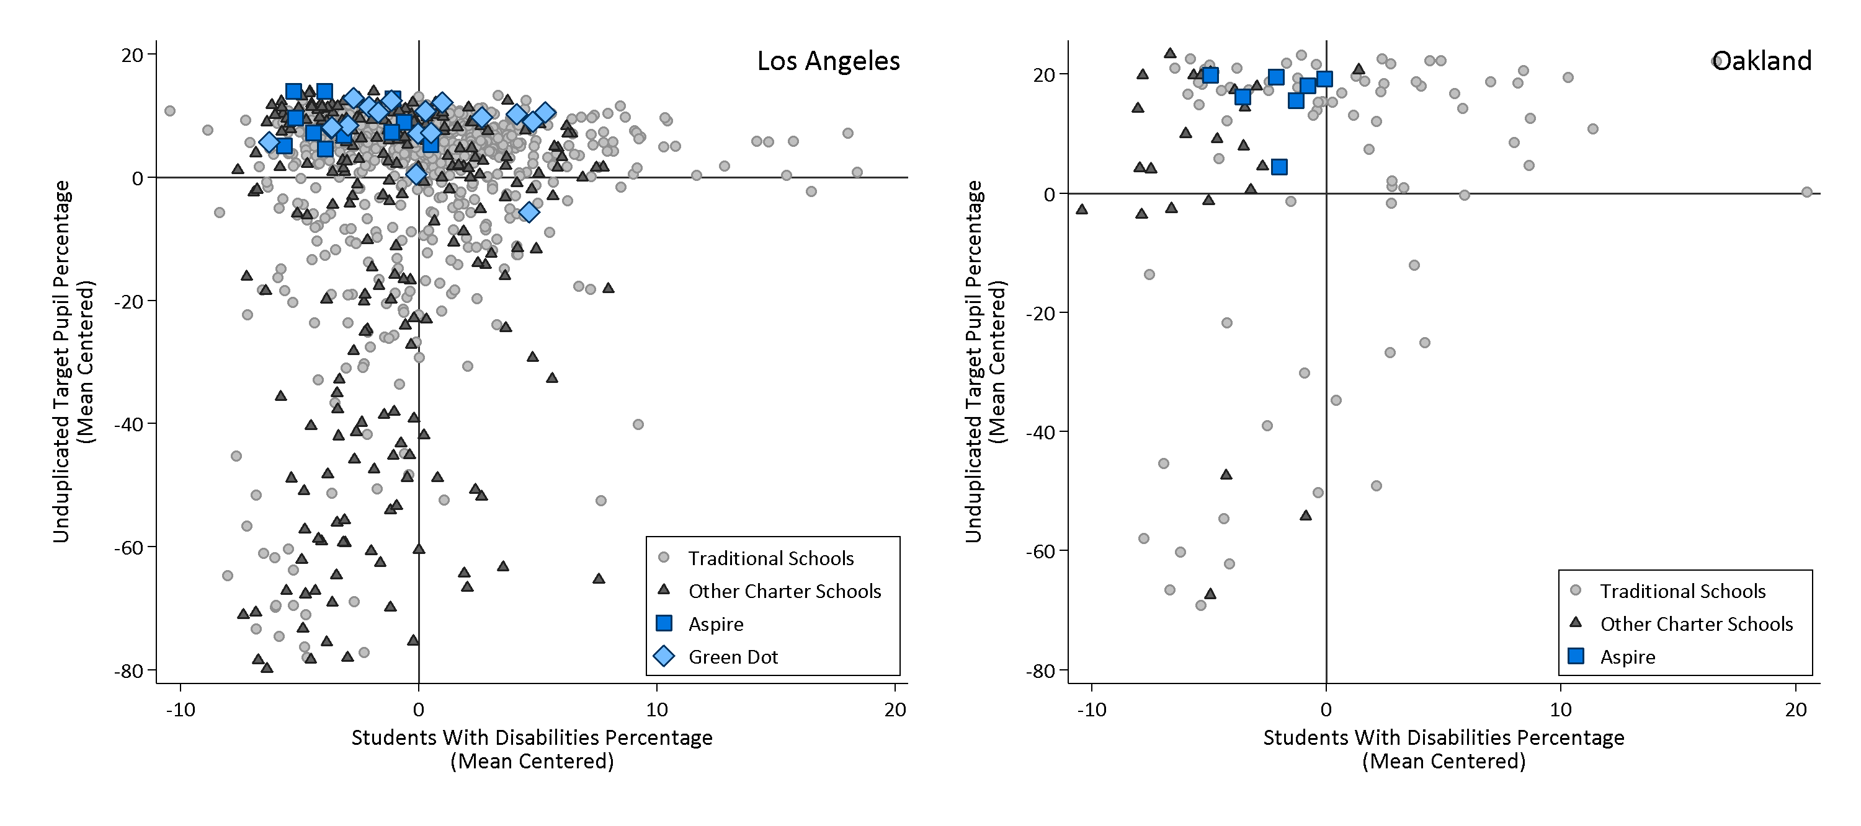
Incidence of Unduplicated Targeted Pupils and Students with Disabilities in Aspire and Green Dot Versus Other LAUSD and OUSD Charter and Traditional Schools (2016-17)
Note: The unduplicated target pupil percentage and students with disabilities percentage were centered on the traditional school enrollment weighted averages within LAUSD and OUSD, respectively.
Notes:
District traditional school averages are weighted by enrollment. The LAUSD average for unduplicated target pupil percentage in 2016–17 was 86.0%, and the LAUSD average for students with disabilities in 2016–17 was 12.6%. The OUSD average for unduplicated target pupil percentage in 2016–17 was 76.6%, and the OUSD average for students with disabilities in 2016–17 was 13.8%. Source: State school demographic data and demographic data provided by LAUSD, OUSD, Aspire, and Green Dot.

Slide 9
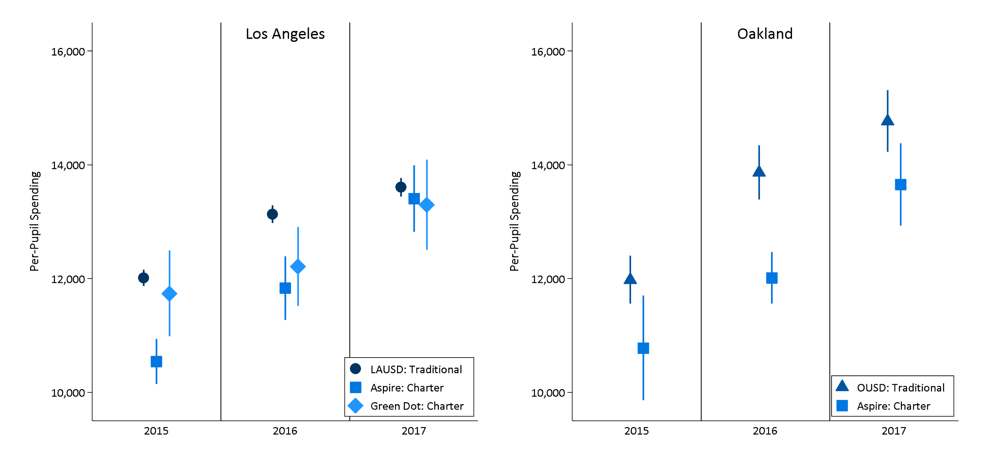
Average Traditional and Charter Per-Pupil Spending in LAUSD and OUSD Unconditional by Year (2014-15 through 2016-17)
Note: These are unconditional comparisons within each district.

Slide 10
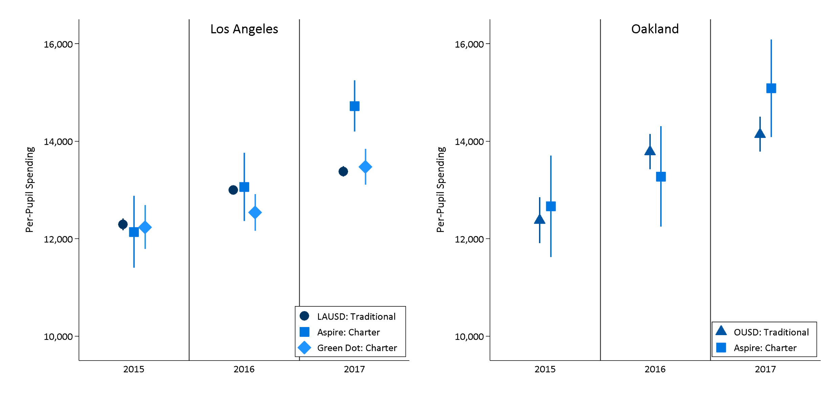
Average Traditional and Charter Per-Pupil Spending in LAUSD and OUSD – Conditional on Student Needs and Grade Configuration by Year (2014-15 through 2016-17)
Note: These are conditional analyses controlling for the percentage of students directly certified (poverty), the percentage of homeless students, the percentage of English learners, percentage of students with common and uncommon disabilities, and grade ranges served.

Slide 11
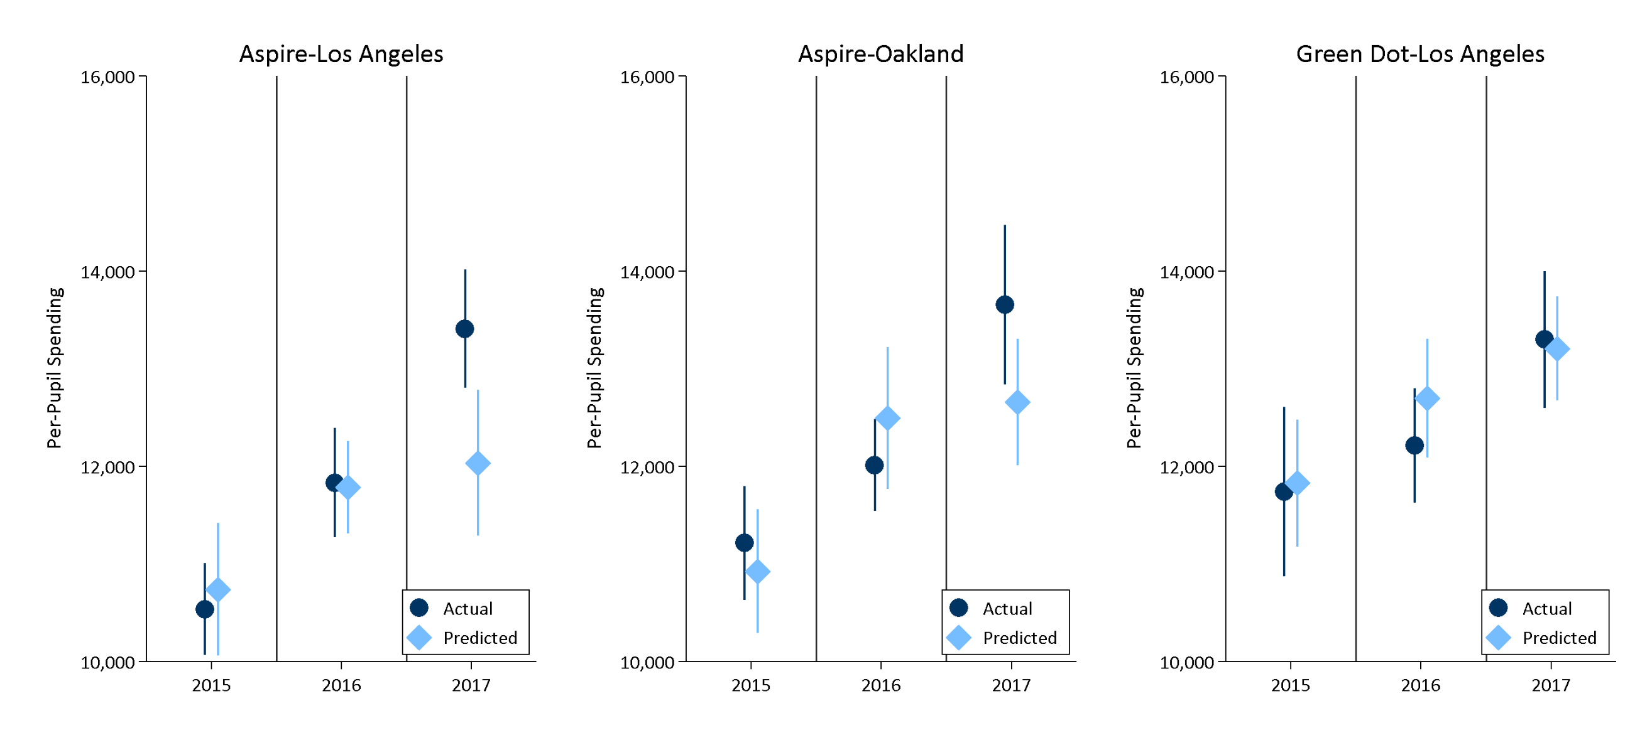
Analysis of Actual Charter and “As-If-Traditional” Predicted Charter Per-Pupil Spending in LAUSD and OUSD by Year (2014-15 through 2016-17)
Note: As-If-traditional predictions are predictions of charter school spending based on regression model results using only traditional schools.

Slide 12
Example of How We Can Improve Research 2
Comparison of Charter and Traditional School Spending in Maryland
  Study Motivation: MD statute stipulates that funding for charter schools must be commensurate with that of traditional schools within the same district.
  Client called for unconditional comparison of average spending between charter and traditional schools within the same district.
  Because student needs differed systematically between charter and traditional schools a conditional analysis was warranted.
  Conducted analysis showing expected average spending on charters if they were treated as if they were traditional schools.
Notes:
U.S. Department of Education, Office of Planning, Evaluation and Policy Development, Policy and Program Studies Service, Exploring the Quality of School-Level Expenditure Data: Practices and Lessons Learned in Nine Sites, Washington, D.C., 2017. Retrieved 04/22/19 at https://www2.ed.gov/rschstat/eval/title-i/quality-expenditure-data/report.pdf.
Levin, J., Baker, B., Atchison, D., Brodziak, I., Boyle, A., Hall, A., and Becker, J. (2016). Study of Funding Provided to Public Schools and Public Charter Schools in Maryland. San Mateo, CA: American Institutes for Research. Retrieved 04/22/19 at http://marylandpublicschools.org/stateboard/Documents/01242017/TabG-CharterPublicSchoolFundingStudy.pdf.

Slide 13
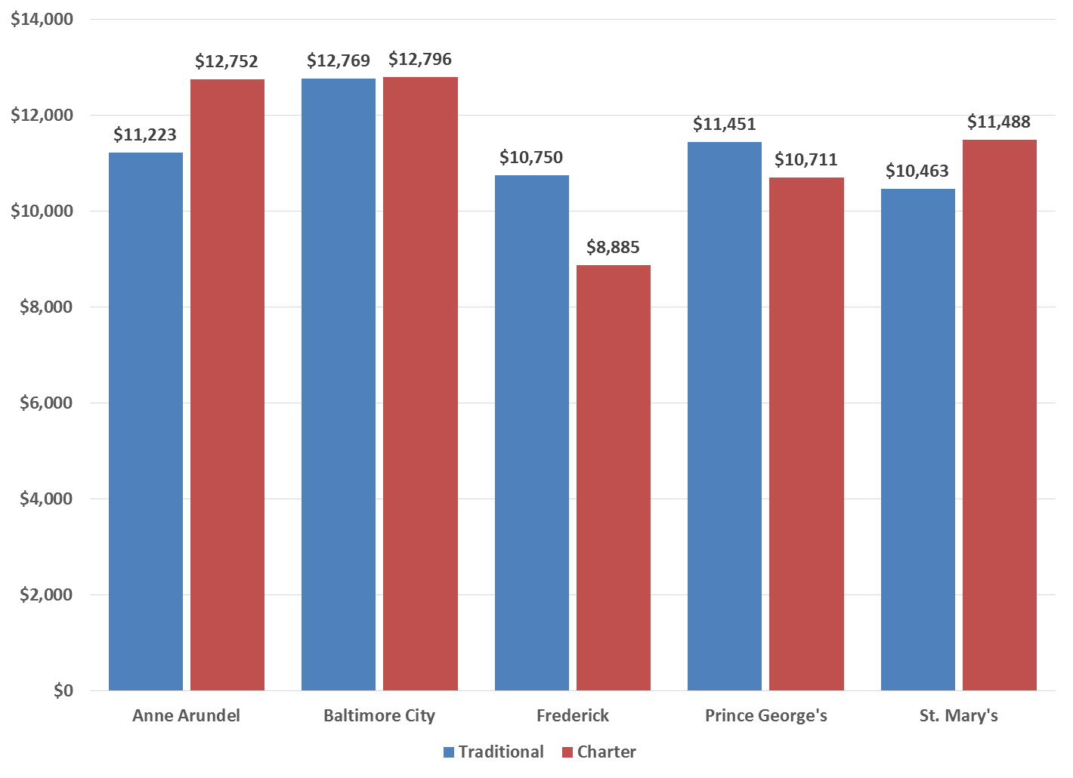
Average Expense per Pupil for Traditional and Charter Schools in Maryland, by School District (2012–13 to 2014–15)
Charter > Traditional
Traditional > Charter
Notes:
Levin, J., Baker, B., Atchison, D., Brodziak, I., Boyle, A., Hall, A., and Becker, J. (2016). Study of Funding Provided to Public Schools and Public Charter Schools in Maryland. San Mateo, CA: American Institutes for Research. Retrieved 04/22/19 at http://marylandpublicschools.org/stateboard/Documents/01242017/TabG-CharterPublicSchoolFundingStudy.pdf.

Slide 14
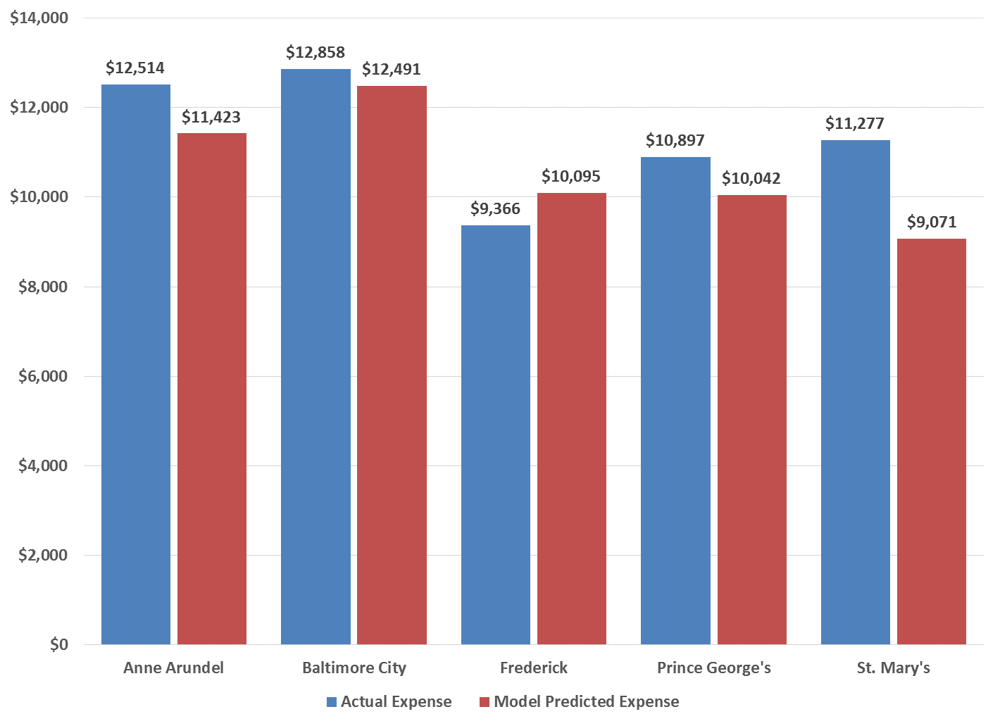
Average Actual Versus Predicted Charter School Per-Pupil Expense by District (2014–15)
Charter Actual > Charter Predicted
Charter Predicted > Charter Actual
Notes:
Levin, J., Baker, B., Atchison, D., Brodziak, I., Boyle, A., Hall, A., and Becker, J. (2016). Study of Funding Provided to Public Schools and Public Charter Schools in Maryland. San Mateo, CA: American Institutes for Research. Retrieved 04/22/19 at http://marylandpublicschools.org/stateboard/Documents/01242017/TabG-CharterPublicSchoolFundingStudy.pdf.

Slide 15
Examples of How We Can Improve Research 3
Agreeing on More Meaningful Measures of Equity
  Problems with traditional equity measures (Coefficient of Variation, Restricted Range, Federal Range, Wealth Neutrality, etc.):
    Measuring equity from different perspectives (child versus taxpayer).
    Measures are “blind” with respect to the underlying relationship between funding and cost factors (student needs, scale of operation and geographic variations in input prices).
    Unsurprisingly, measures are not consistent with one another.
  Should agree on using more rigorous measures such as implicit weights.
  Weights should necessarily control for common cost factors that often reflect underlying funding policies (adjustments for cost factors).
  Avoid “slightly” conditional analysis where only one factor is controlled for.
  Decompose how different pots of money vary according to cost factors by running analysis on overall, unrestricted and restricted funding/spending.
Notes:
U.S. Department of Education, Office of Planning, Evaluation and Policy Development, Policy and Program Studies Service, Exploring the Quality of School-Level Expenditure Data: Practices and Lessons Learned in Nine Sites, Washington, D.C., 2017. Retrieved 04/22/19 at https://www2.ed.gov/rschstat/eval/title-i/quality-expenditure-data/report.pdf.
Levin, J., Baker, B., Atchison, D., Brodziak, I., Boyle, A., Hall, A., and Becker, J. (2016). Study of Funding Provided to Public Schools and Public Charter Schools in Maryland. San Mateo, CA: American Institutes for Research. Retrieved 04/22/19 at http://marylandpublicschools.org/stateboard/Documents/01242017/TabG-CharterPublicSchoolFundingStudy.pdf.

Slide 16
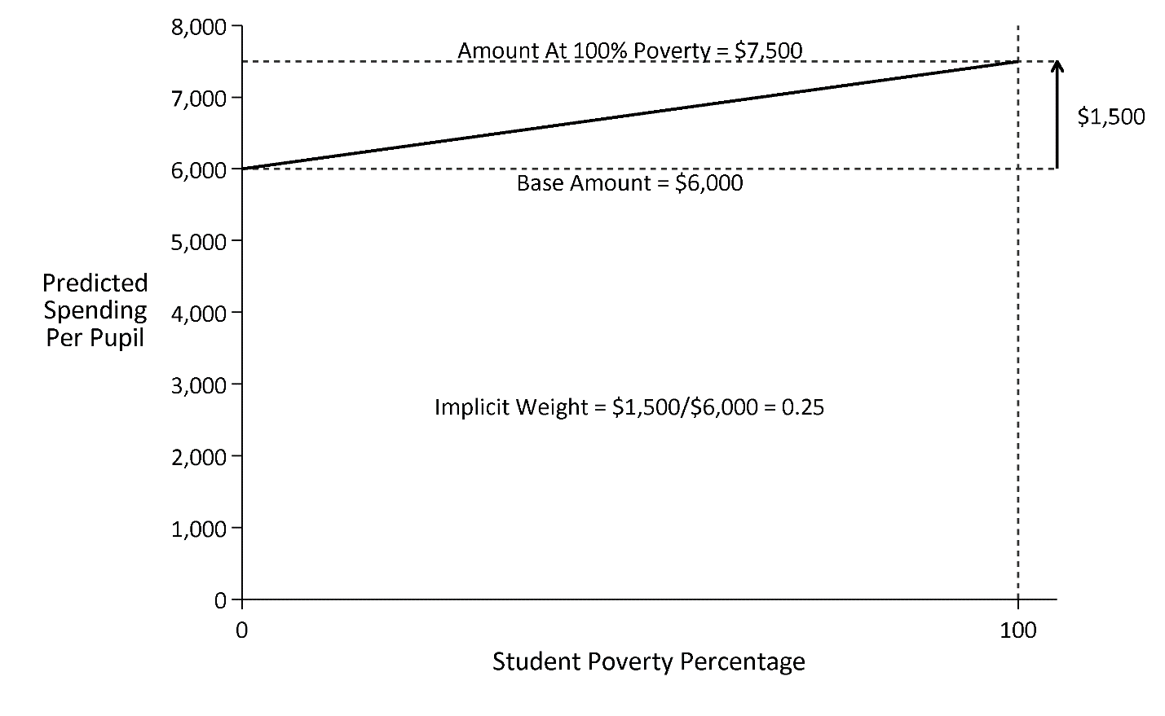
Graphical Example of Implicit Weight Calculation
Notes:
U.S. Department of Education, Office of Planning, Evaluation and Policy Development, Policy and Program Studies Service, Exploring the Quality of School-Level Expenditure Data: Practices and Lessons Learned in Nine Sites, Washington, D.C., 2017. Retrieved 04/22/19 at https://www2.ed.gov/rschstat/eval/title-i/quality-expenditure-data/report.pdf.
Levin, J., Baker, B., Atchison, D., Brodziak, I., Boyle, A., Hall, A., and Becker, J. (2016). Study of Funding Provided to Public Schools and Public Charter Schools in Maryland. San Mateo, CA: American Institutes for Research. Retrieved 04/22/19 at http://marylandpublicschools.org/stateboard/Documents/01242017/TabG-CharterPublicSchoolFundingStudy.pdf.

Slide 17
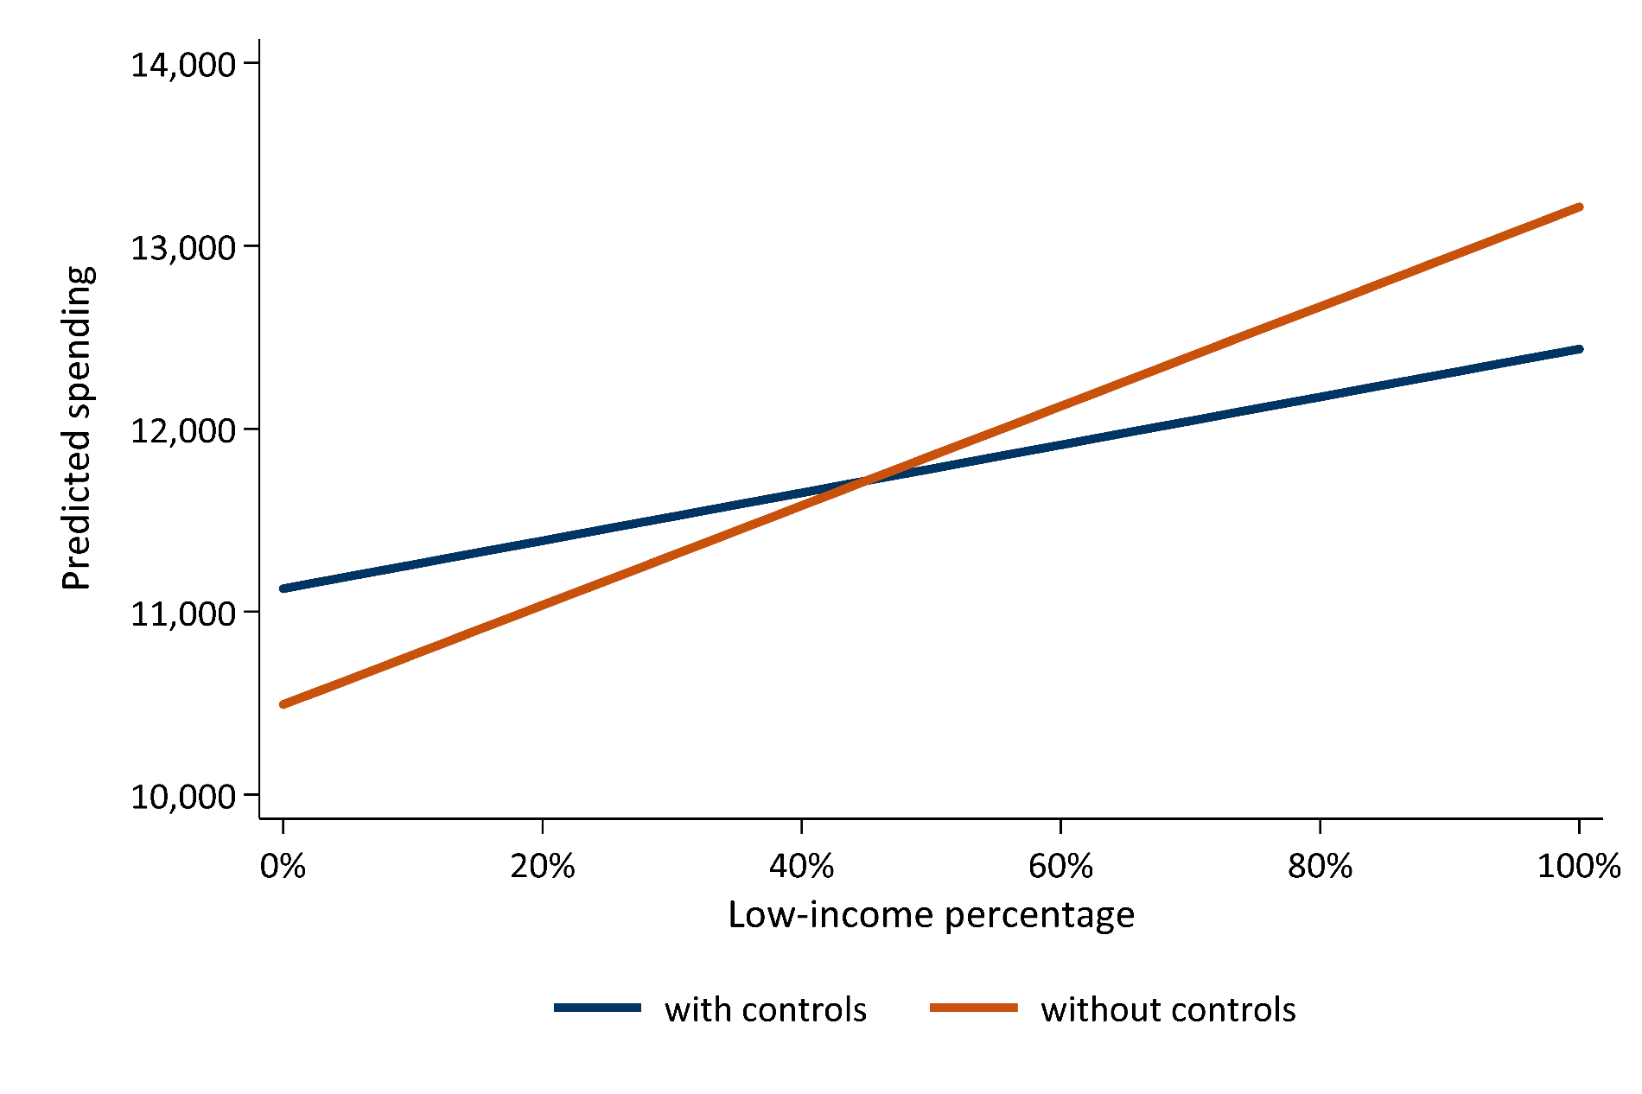
Graphical Example of Slightly and Fully Conditional Implicit Weight Estimates for State of Maryland
26.3%
11.9%
Notes:
U.S. Department of Education, Office of Planning, Evaluation and Policy Development, Policy and Program Studies Service, Exploring the Quality of School-Level Expenditure Data: Practices and Lessons Learned in Nine Sites, Washington, D.C., 2017. Retrieved 04/22/19 at https://www2.ed.gov/rschstat/eval/title-i/quality-expenditure-data/report.pdf.
Levin, J., Baker, B., Atchison, D., Brodziak, I., Boyle, A., Hall, A., and Becker, J. (2016). Study of Funding Provided to Public Schools and Public Charter Schools in Maryland. San Mateo, CA: American Institutes for Research. Retrieved 04/22/19 at http://marylandpublicschools.org/stateboard/Documents/01242017/TabG-CharterPublicSchoolFundingStudy.pdf.

Slide 18
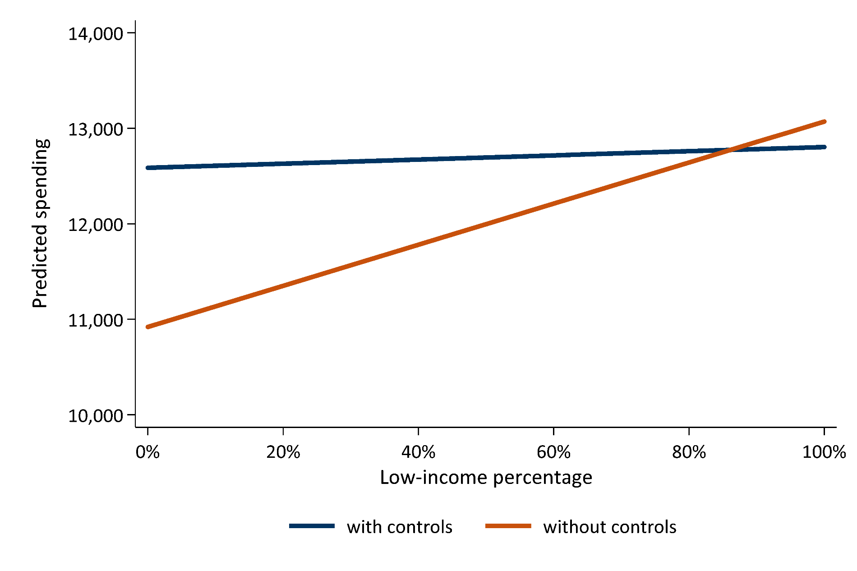
Graphical Example of Slightly and Fully Conditional Implicit Weight Estimates for Baltimore City Public Schools
20.1%
1.7%
Notes:
U.S. Department of Education, Office of Planning, Evaluation and Policy Development, Policy and Program Studies Service, Exploring the Quality of School-Level Expenditure Data: Practices and Lessons Learned in Nine Sites, Washington, D.C., 2017. Retrieved 04/22/19 at https://www2.ed.gov/rschstat/eval/title-i/quality-expenditure-data/report.pdf.
Levin, J., Baker, B., Atchison, D., Brodziak, I., Boyle, A., Hall, A., and Becker, J. (2016). Study of Funding Provided to Public Schools and Public Charter Schools in Maryland. San Mateo, CA: American Institutes for Research. Retrieved 04/22/19 at http://marylandpublicschools.org/stateboard/Documents/01242017/TabG-CharterPublicSchoolFundingStudy.pdf.

Slide 19
Jesse Levin
Principal Research economist jlevin@air.org
Copyright © 2019 American Institutes for Research. All rights reserved.

