Slide 1
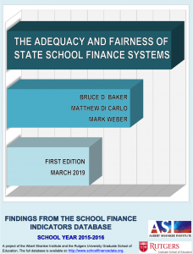
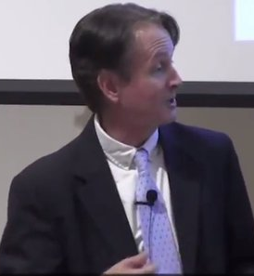


School Finance Indicator Database
Dude, look at that scatterplot!
Love this stuff!
You’re telling me? Glad I’m done with that Ph.D!
He’s at it again Jazzman!

Slide 2
Core Principles
Proper funding is a necessary condition for educational success: Competitive educational outcomes require adequate resources, and improving educational outcomes requires additional resources.
The cost of providing a given level of educational quality varies by context: Equal educational opportunity requires progressive distribution of resources, targeted at students and schools that need them most.
The adequacy and fairness of education funding are largely a result of legislative policy choices: Good school finance policy can improve student outcomes, whereas bad policy can hinder those outcomes.

Slide 3
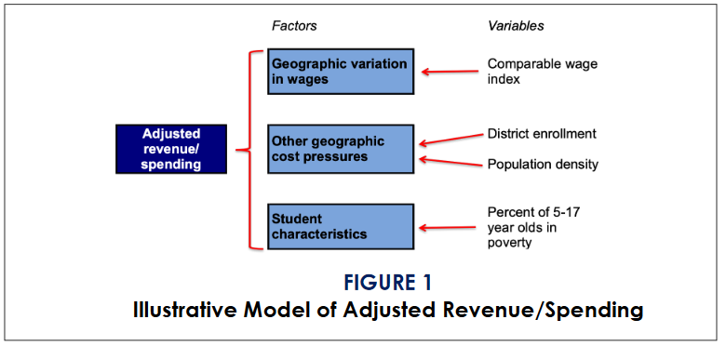
Generating Comparable Revenue Measures

Slide 4
Core Indicators
Effort: how much of a state’s total resources or capacity are spent directly on K-12 education;
Adequacy: whether states provide sufficient resources to districts, relative to other states or to common outcome goals (e.g., test scores);
Progressivity: whether states allocate more resources to districts serving larger proportions of disadvantaged children.

Slide 5
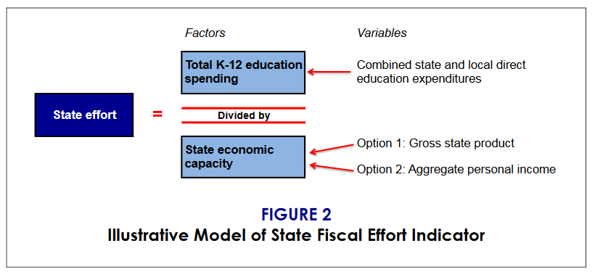
Effort

Slide 6
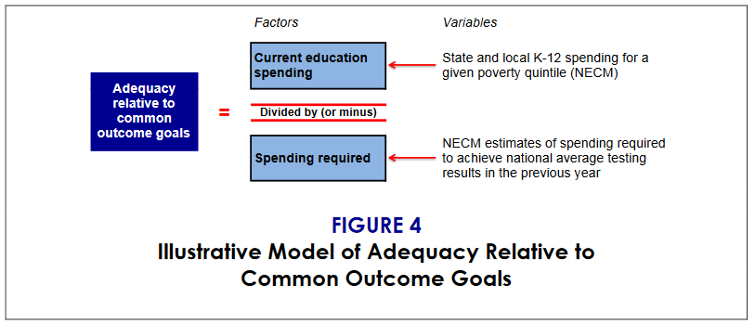
Adequacy

Slide 7

Structural/
Geographic Constraints
Input Prices
Student Population
Measured Student Outcomes
Spending
Cost
Inefficiency
Efficiency Controls: Fiscal capacity, competition, & public monitoring
Notes:
<FN>Figure 9.1
<FT>Factors affecting education costs and efficiency

Slide 8
Current Average Resources
Adequacy Target Exceeds Current Average
Actual Distribution
Current Average Outcomes
Outcomes
Equal Opportunity
Intercept
Adequacy Cost
Exceeds Current Average
Resources
Notes:
<FN>Figure 1Linking Resources, Outcomes and Adequacy Targets
0.1
<FT>Linking resources, outcomes, and adequacy targets

Slide 9
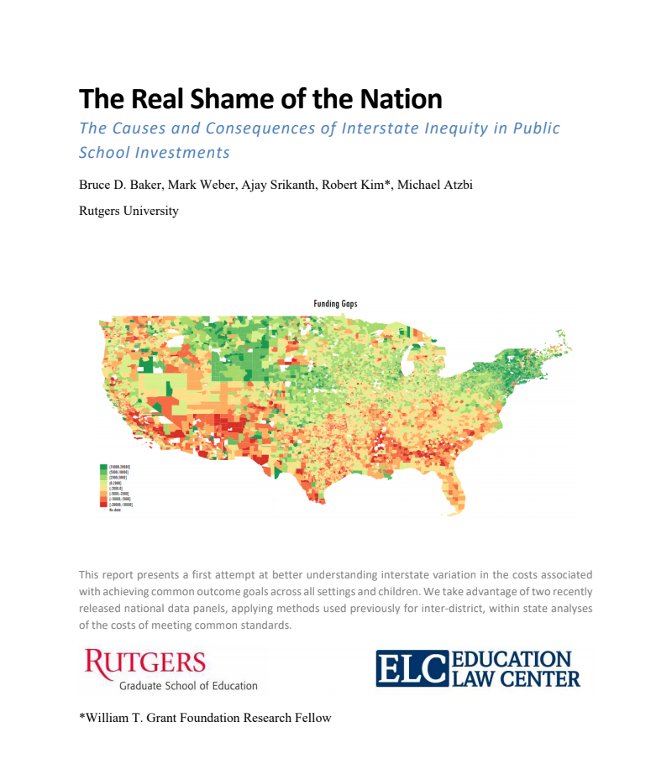
Current spending (2013-2015) as % of “cost” of achieving national average outcomes (red = lower, green = higher)
Current outcomes (2013-2015) with respect to national average outcomes (red = lower, blue = higher)

Slide 10
Progressivity
Substantial progressivity: The ratio of adjusted state and local revenue in higher-poverty districts (10, 20, or 30 percent poverty) to that of the lowest-poverty districts (0 percent poverty) within a given state.
Systematic progressivity: The correlation between revenue and poverty (labor market centered) among all districts within a given state.

Slide 11
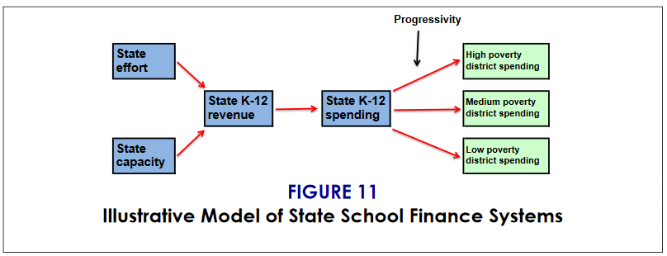
Describing State School Finance Systems

Slide 12
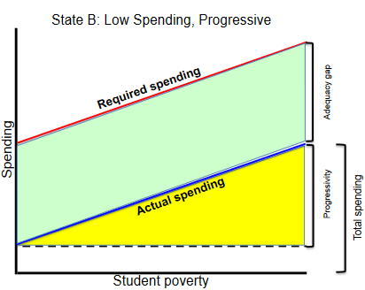
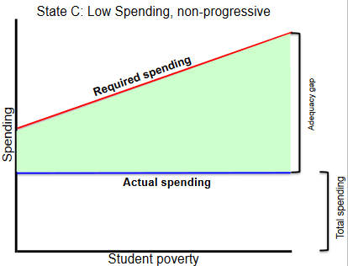
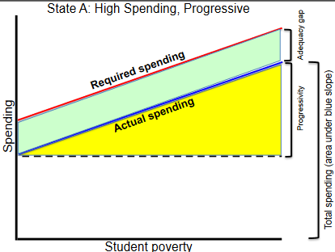
Describing State School Finance Systems

Slide 13
Evaluating School Finance Systems
Effort: All else being equal, more effort is better, particularly for states with less capacity. Conversely, however, states with larger economies may not require as much effort as states with smaller economies.
Adequacy: In light of widespread agreement that educational outcomes in the U.S. must improve, we assert, as a general principle, that allocating more resources to schools is better. However, states should also provide resources to schools that are commensurate with achieving common outcomes or improvement toward those outcomes.
Progressivity: States’ allocation of resources should be progressive -–i.e., districts serving more high-needs students should receive more revenue. The optimal degree of progressivity, however, might depend on factors such as the amount of inequality of education outcomes (for example, states with large achievement gaps might allocate resources more progressively)

Slide 14
Resource Indicators
Teacher/non-teacher wage competitiveness: Comparison of teachers’ wages to wages of other professionals in the same state, controlling for factors such as age and education.
Predicted staffing ratios: Teacher-per-student ratios by district poverty adjusted for district size, regional wage variation, and population density. Can be compared with high-and low-poverty districts in each state.
Predicted class size: Average class size by district poverty, for both departmentalized and self-contained classes, adjusted for district size, regional wage variation, and population density. Can be compared with high-and low-poverty districts in each state.
Teacher salary competitiveness: Ratio of actual to predicted teacher salaries, adjusted for degree, experience, and labor market, by poverty (poverty as a percentage of poverty within the labor market). Can be compared with high-and low-poverty districts in each state.
Coverage and charter market share: The number of school-aged students enrolled in public schools as a percentage of all school-aged children, as well as total charter school market share by state (percent of all public school students enrolled in charter schools).
Income-based early childhood schooling gap: The number of 3-and 4-year-olds from low-income families enrolled in school as a percentage of the total number of 3-and 4-year-olds enrolled in school.

Slide 15
Relationships Among Indicators
Triangulating Indicators to Characterize State Systems

Slide 20
Relationships to Other Indicators
Cutting through the Clutter

Slide 22
Correlations among Equity Indicators

Slide 24
Effort and Adequacy Measures

Slide 25
The Road Ahead
We need to rally our forces around core principles. Many (most) of us largely agree on the core principles:
  Proper funding is a necessary condition for educational success: Competitive educational outcomes require adequate resources, and improving educational outcomes requires additional resources.
  The cost of providing a given level of educational quality varies by context: Equal educational opportunity requires progressive distribution of resources, targeted at students and schools that need them most.
  The adequacy and fairness of education funding are largely a result of legislative policy choices: Good school finance policy can improve student outcomes, whereas bad policy can hinder those outcomes.

Slide 26
The Road Ahead
We need to clear the clutter when it comes to indicators of state school funding systems
  Indicators should address core principles:
  Indicators involving spending measures must sort out “good” (equitable, cost-based) variation from “bad” (inequitable) variation
    Address regional variation in labor costs
    Address economies of scale and population sparsity
    Address student need related cost factors
We need to work as a team to help state policymakers understand the relationships among our indicators, and what they say collectively about state school finance systems!

